Slide 1

SRM INSTITUTE OF SCIENCE AND TECHNOLOGY
SCHOOL OF COMPUTING
DEPARTMENT OF NETWORKING AND COMMUNICATIONS
18CSP107L / 18CSP108L MINOR PROJECT / INTERNSHIP
26/10/2024
AI-based Financial Advisor for Stock Market Predictions with Cloud-Integration
Guide Name: Student Name & Registration Number:
Mrs. Vijayalakshmi V Rachit Sood [RA2111028010110]
Assistant Professor Papai Mondal [RA2111028010116]
Asmi Shrivastava [RA2111028010119]
Department of NWC

Slide 2
Table of Contents
Abstract
Introduction
Problem Statement
Literature Survey
Objectives
Methodology
User Story
Functional Test Cases
Implementation and Result
Conclusion
References

Slide 3
Abstract
The research aims to enhance AI-based personal finance advisors for stock market investments by addressing critical challenges identified in existing systems. The objectives include improving algorithmic flexibility, bolstering data security, and mitigating algorithmic bias to ensure fair and equitable recommendations. The study also focuses on increasing transparency and explainability of AI models, aligning them with regulatory standards to build investor trust, and integrating behavioural finance insights to capture investor sentiments more accurately. Through these advancements, the research seeks to create a more reliable, secure, and user-centric AI-driven financial advisory system.

Slide 4
Introduction
Investing in the stock market is complex, with constantly changing prices and global events affecting market conditions. Traditionally, financial consultants have provided advice, but their services are expensive and inaccessible for many.
The integration of AI, has enhanced real-time analysis of large datasets, improving prediction accuracy and personalized advice. Combining AI with cloud computing offers scalability and provide secure, real-time financial advisory services.
With advancements in technology, Artificial Intelligence (AI) and machine learning (ML) are transforming financial advisory services. Early systems analysed stock trends but lacked accuracy and personalized recommendations.
With the use of AI for stock market investments we utilize cloud computing to address challenges like bias, data security, and scalability.

Slide 5
Problem Statement
According to our research, stock market presents significant challenges due to unpredictable and volatile nature of stock prices.
Although AI-based financial advisory systems have emerged to provide automated investment recommendations, they often face limitations in scalability, real-time data processing, and prediction accuracy.
Moreover, issues such as data security, algorithmic bias, and transparency remain unresolved in many AI models, preventing widespread adoption.
Our project focuses on using cloud computing to build a reliable, secure, and scalable AI financial advisor that addresses these challenges for stock market investments.

Slide 6
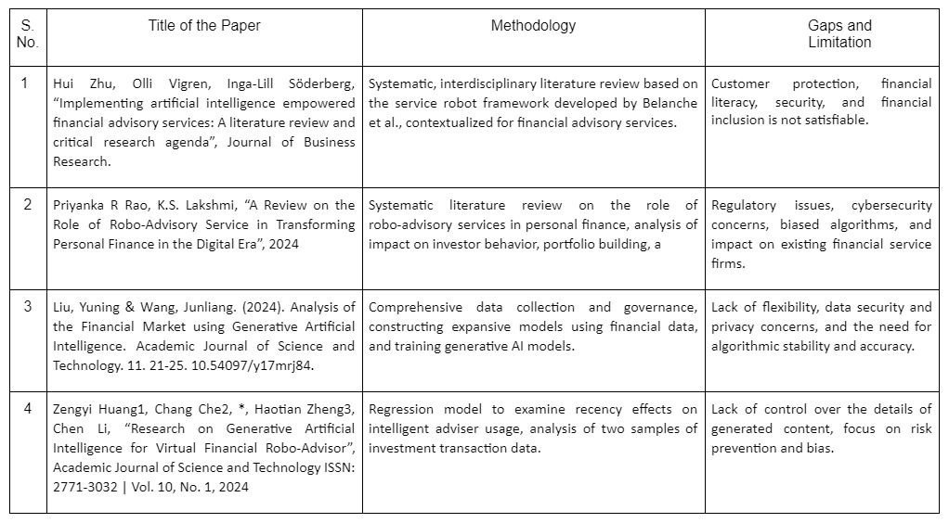
Literature Survey

Slide 7
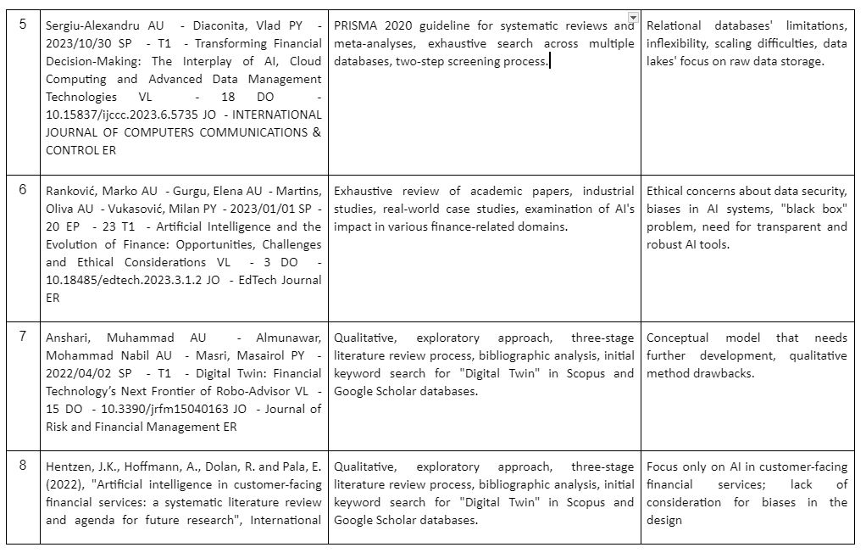

Slide 8
Objective
To develop cloud-based dashboards and to leverage the scalability of cloud computing to efficiently handle large-scale data processing and complex computations required for real-time stock market analysis and to provide investment recommendations.

Slide 9
Methodology
This research develops an AI-based personal finance advisor to provide real-time stock market predictions. First, historical stock market data is collected and preprocessed to ensure data quality. Various models, including traditional time series models (e.g., ARIMA, Holt-Winters) and machine learning model (Random Forest), are trained using cloud-based platforms to leverage scalability. The models are then evaluated using accuracy metrics like SMAPE and RMSE to select the best-performing model. The model is deployed on StreamLit Cloud for real-time user interaction, allowing users to input stock symbols and receive predictions. The results are cumulated to create a comparative study of all the algorithms implemented.

Slide 10
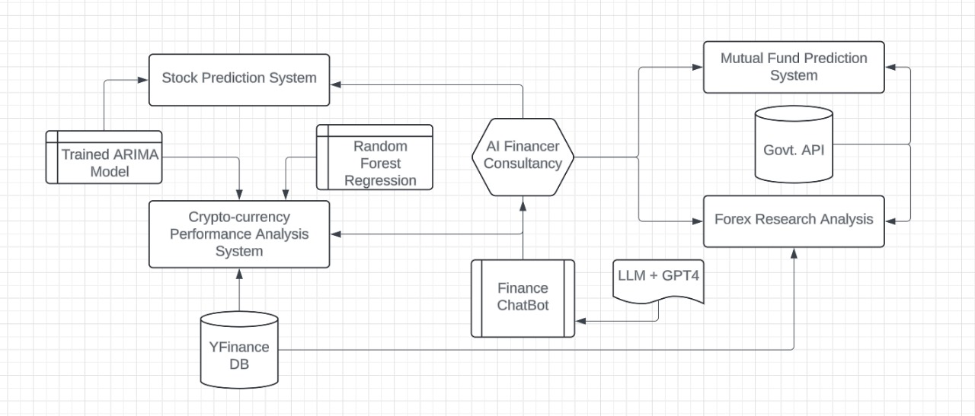
Architecture

Slide 11
Modules
The methodology involves the development and deployment of an AI-driven financial advisory system that predicts stock market trends and provides investment recommendations using various forecasting models and cloud computing for scalability. The system comprises several modules:
1. Data Collection:
Gathered historical stock market data, including stock prices, volumes, and relevant financial indicators using Yahoo Finance dataset.
Utilized the yfinance library to seamlessly access for retrieving historical stock market data, including prices, trading volume, dividends, and splits.
Stored the data in a structured format (CSV/Database) for easy access during model training and testing.
Implemented data retrieval scripts to automate the extraction of up-to-date stock data periodically.

Slide 12
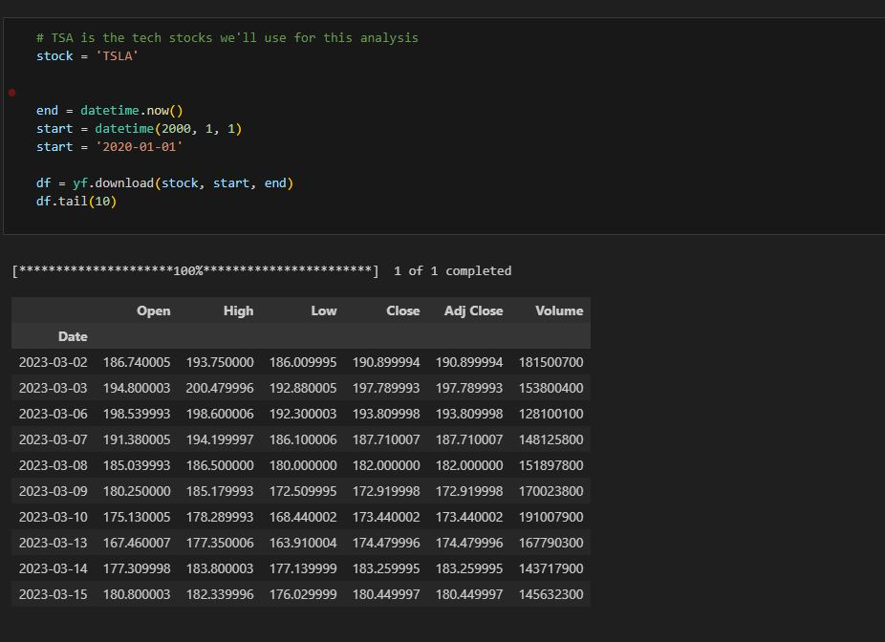
Dataset Attributes are attached in the figure:

Slide 13
2. Data Preprocessing:
We cleaned and preprocessed the raw data by handling missing values, outliers, and normalizing the data.
Removed incomplete weeks, months, and quarters to maintain data consistency based on the selected frequency (daily, weekly, monthly, quarterly).
Extracted useful features such as moving averages, volatility, and other technical indicators that influence stock prices.
Lastly, we ensured that the data aligns with the correct frequency (daily, weekly, monthly, quarterly) and fills or removes missing values.
This module also focused on calculating the Symmetric Mean Absolute Percentage Error (SMAPE), used to measure the accuracy of forecast models.

Slide 14
3. Model Development:
Trained a variety of time series forecasting models, including ARIMA, Holt-Winters, and Simple Exponential Smoothing (SES), to capture historical trends.
Fine-tuned model parameters (e.g., ARIMA's p, d, q values) to achieve optimal performance for different stock price intervals.
Implemented machine learning model Random Forest to analyze non-linear patterns and make predictions.
We fine-tuned hyperparameters such as the number of estimators and tree depth in the Random Forest model to optimize its performance.
Evaluated model performance using SMAPE to ensure accuracy in both high and low stock price forecasts.
Compared models by testing them on different intervals (daily, weekly, monthly) to determine the most effective forecasting approach.

Slide 15
4. Model Evaluation and Selection:
Evaluated the accuracy of each model using metrics such as SMAPE (Symmetric Mean Absolute Percentage Error) and RMSE (Root Mean Square Error).
Compared traditional models(ARIMA) with machine learning model(Random Forest) to determine the most accurate model for predicting stock prices.
SMAPE Analysis:
Simple Exponential Smoothing:
SMAPE for High: 0.028
SMAPE for Low: 0.03
ARIMA Model:
SMAPE for High: 0.018
SMAPE for Low: 0.021
Random Forest:
SMAPE for High: 0.016
SMAPE for Low: 0.019

Slide 16
5. Cloud-Based Deployment:
We deployed the selected model on StreamLit Cloud, providing a user-friendly interface for interacting with the AI-based advisor while also handling the large dataset.
Configured the deployment environment on Streamlit Cloud, ensuring compatibility with necessary libraries and frameworks.
We implemented data preprocessing steps in the deployment pipeline to ensure that input data is formatted correctly before predictions.
Managed dependencies using a requirements.txt file for seamless installation.
Lastly, we created user-friendly error messages to guide users in case of input errors or data unavailability.

Slide 17
Algorithms
ARIMA (AutoRegressive Integrated Moving Average) is used for time series forecasting of stock prices. For our project, this is how its working:
Stationarity: ARIMA requires the time series data to be stationary. This means that the mean and variance should be constant over time. We can perform differencing to achieve stationarity.
Parameters: ARIMA is characterized by three parameters:
p: The number of lag observations (autoregressive part).
d: The degree of differencing (integrated part).
q: The size of the moving average window.
Forecasting: Once the model is fitted, we can use it to make predictions on future stock prices. ARIMA generates forecasts based on past values and the identified parameters.
Evaluation: Finally, we evaluated the model's performance using metrics like Root Mean Squared Error (RMSE) to determine its accuracy.

Slide 18
Random Forest is used for predicting stock prices based on historical data. For our project, this is how its working:
Historical stock price data is collected, along with relevant features (e.g., trading volumes). The data is then preprocessed, which involved normalization and handling missing values.
Model Training:
Ensemble Learning: Random Forest is an ensemble learning method that builds multiple decision trees during training. Each tree is trained on a random subset of the data.
Bagging: It uses the bootstrap aggregating (bagging) technique, which involves sampling with replacement to create different training datasets for each tree.
Prediction: For predicting stock prices, each decision tree in the forest makes a prediction, and the final output is obtained by averaging the predictions.
Evaluation: The model's performance is evaluated using metrics like Root Mean Squared Error (RMSE) on the test set to assess its accuracy.

Slide 19
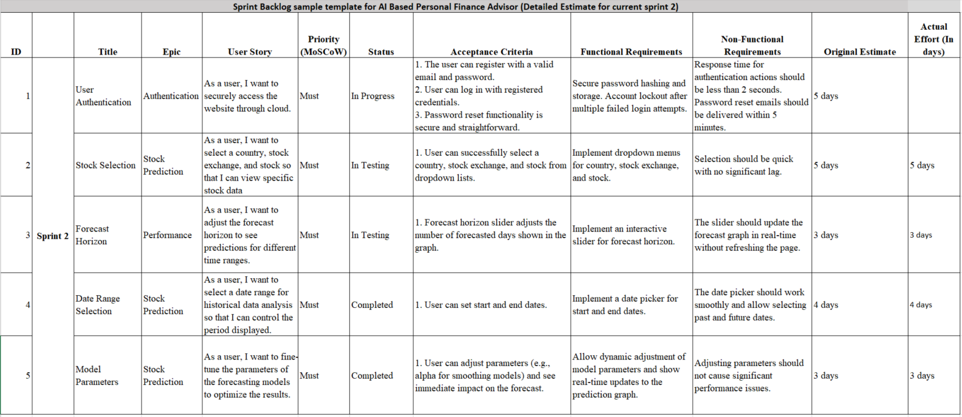
User Story

Slide 20
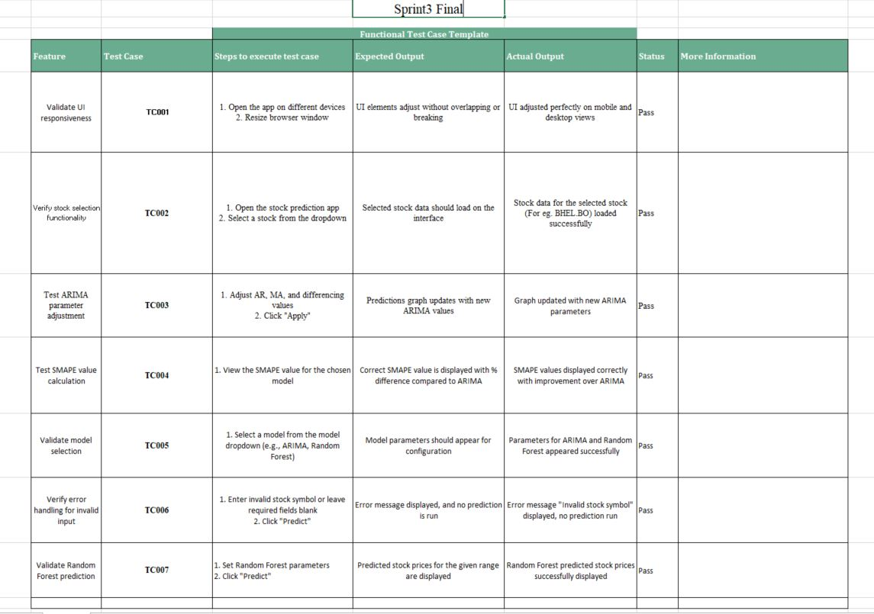
Functional Test Cases

Slide 21
Implementation
For sprint 3, we have implemented the following:
Step 1: We have successfully created a homepage for the system and created hyperlinks to the stock predictions page.
Step 2: In the predictions page, we have implemented AI models like the ARIMA and Random Forest along with options to choosing stocks, start and end date, intervals and periods.
Step 3: After selecting our necessary required conditions the prediction system provides us with a visualization in the form of a graph of current and upcoming trends.

Slide 22
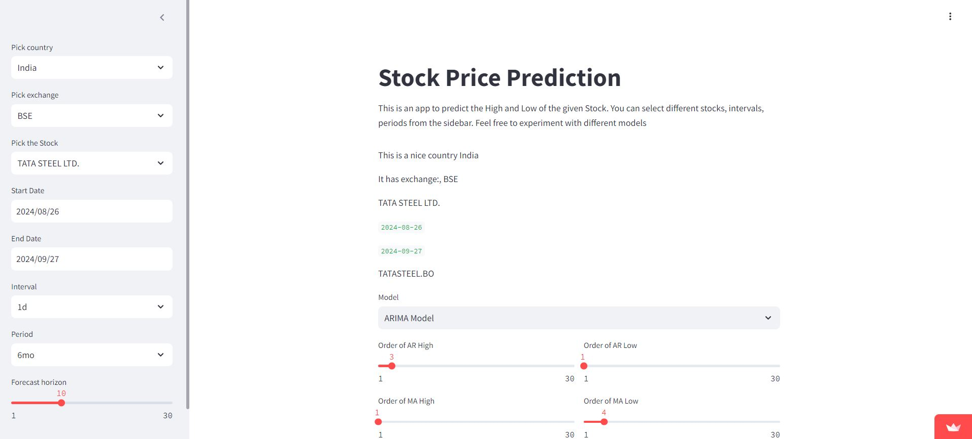

Slide 23
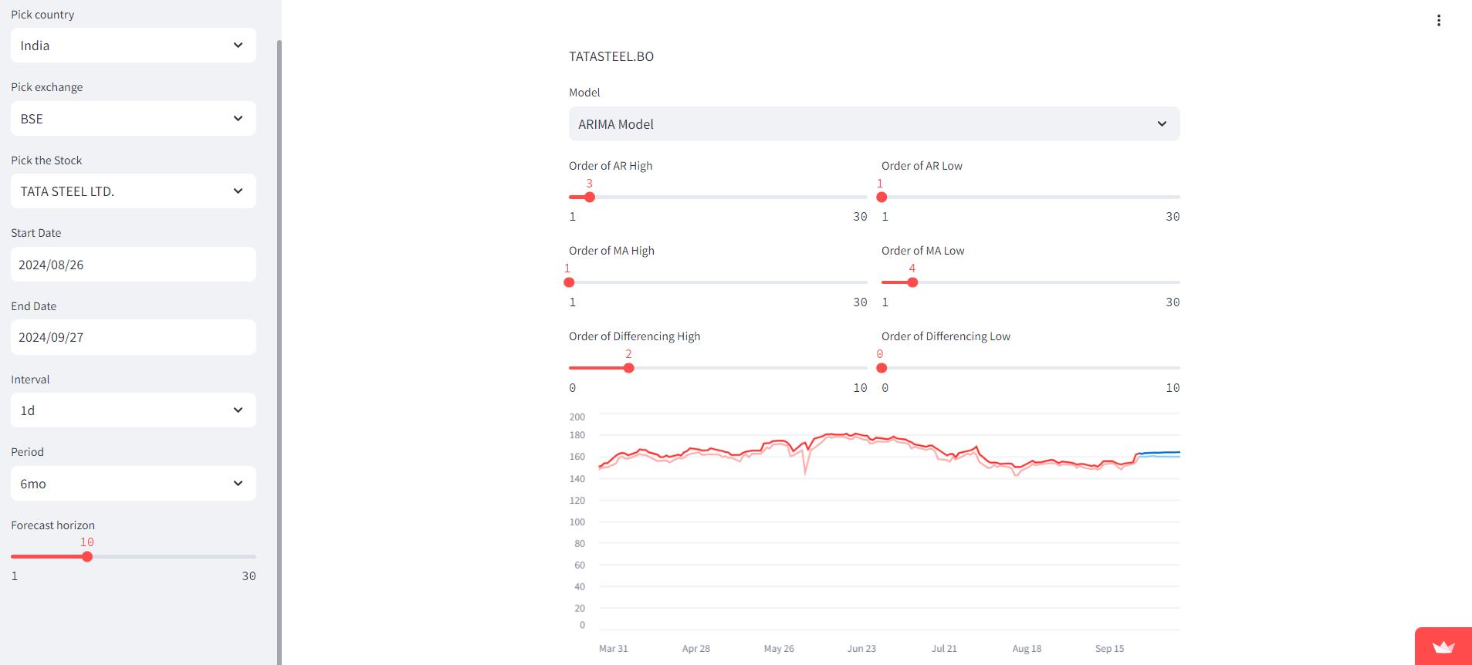

Slide 24
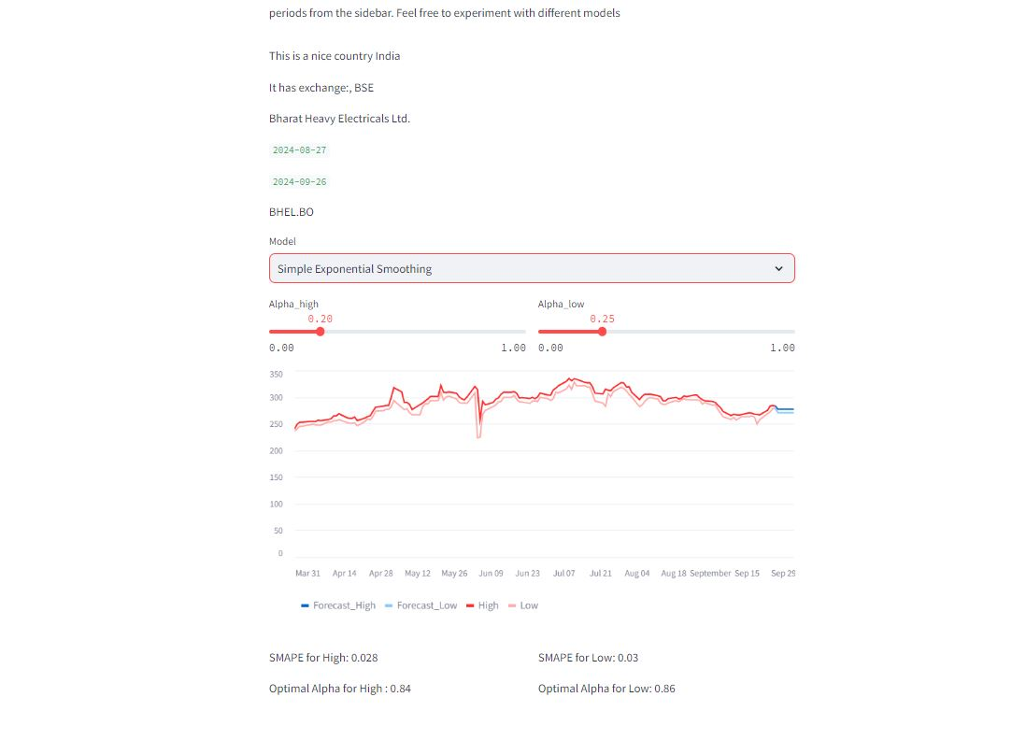
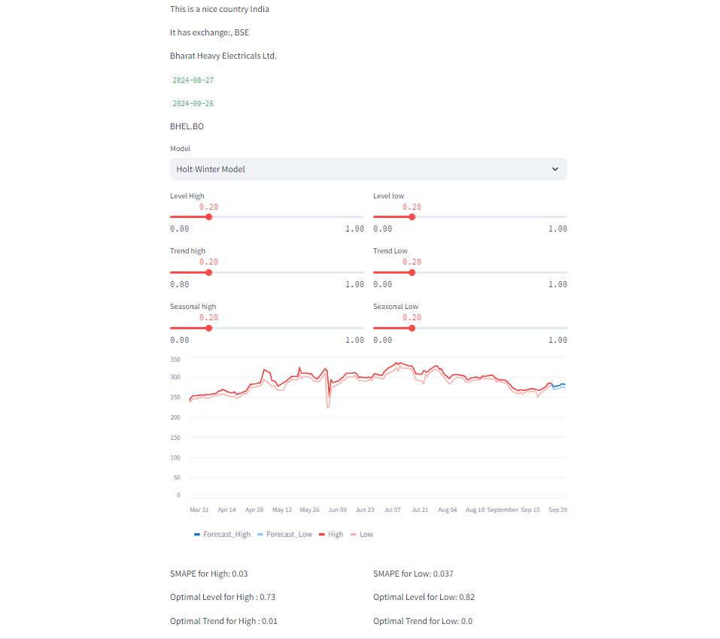

Slide 25
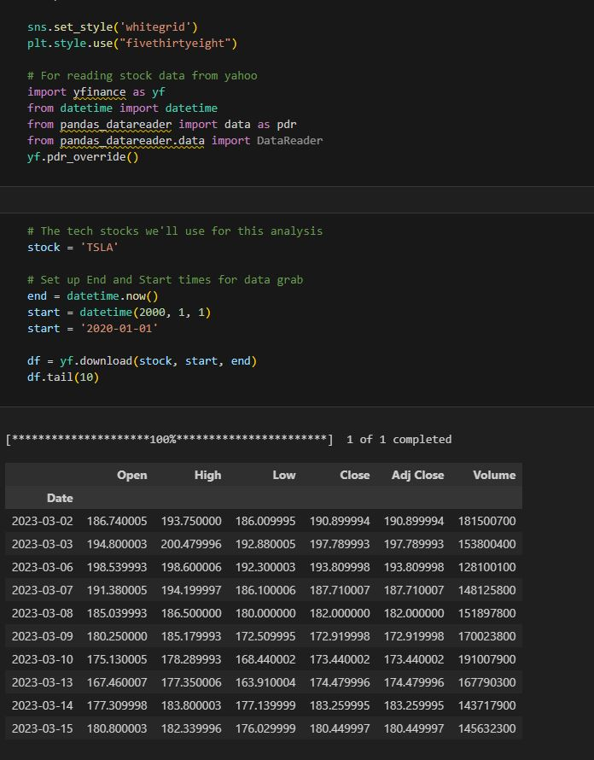
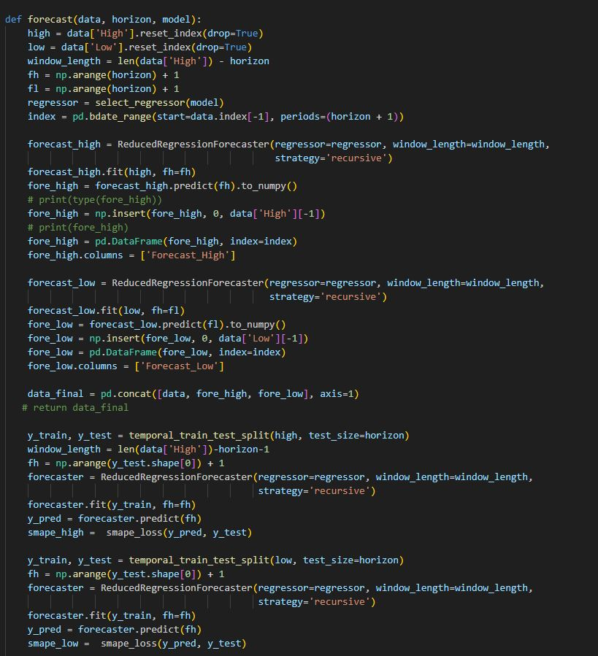

Slide 26
Result
For Sprint 3, in terms of forecasting accuracy, the ARIMA model demonstrates significant improvements over both the Simple Exponential Smoothing (SES) and Holt-Winters models. When compared to SES, ARIMA shows a 35.71% improvement in accuracy for high predictions and a 30% improvement for low predictions. Similarly, ARIMA outperforms the Holt-Winters model with a 40% improvement for high predictions and a 43.24% improvement for low predictions.
Lastly, a comparison between the earlier best model ARIMA and Random Forest model was made and it was concluded that it was the best model of them all with a improvement of 11.11% over ARIMA.

Slide 27
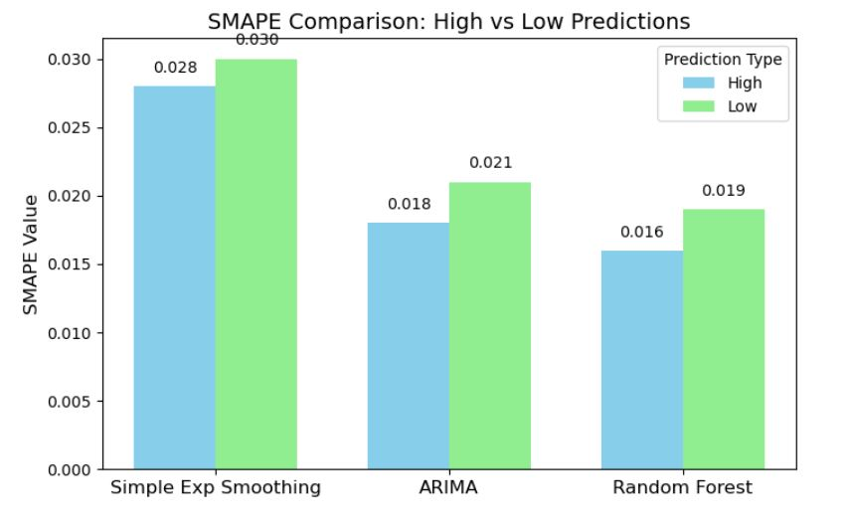
SMAPE Comparison between models from the SMAPE values acquired from the implementation:

Slide 28
Conclusion
This research develops an AI-based personal finance advisor focused on stock market investments, utilizing cloud computing to enhance performance, scalability, and real-time decision-making. The system tackles key challenges like data security, algorithmic bias, and transparency, ensuring that users receive reliable and personalized financial advice. By integrating advanced AI models and cloud infrastructure, the solution makes investment guidance more accessible, affordable, and accurate.
Future improvements will focus on refining prediction models, expanding global market data, and continuously optimizing for fairness and compliance.

Slide 29
References
[1] Implementing artificial intelligence empowered financial advisory services: A literature review and critical research agenda Hui Zhu , Olli Vigren , Inga-Lill Soderberg, Journal of Business Research Volume 174 , March 2024, 114494.
[2] A Review on the role of Robo - advisory service in transforming Personal Finance in the Digital - Era Priyanka R Rao,Dr. K.S. Lakshmi, Journal of Informatics Education and Research Volume 4, 2024, 1526-4726.
[3] Analysis of Financial Market using Generative Artificial Intelligence Yuning Liu1, Junliang Wang2, Academic Journal of Science and Technology ,Volume 11, 2024, 2771-3032.
[4] Research on Generative Artificial Intelligence for Virtual Financial Robo‐Advisor Zengyi Huang1, Chang Che2, Haotian Zheng3, Chen Li4, Academic Journal of Science and Technology, Volume 10, 2024, 2771-3032.
[5] Transforming Financial Decision-Making: The Interplay of AI, Cloud Computing and Advanced Data Management Technologies, Sergiu-Alexandru Ionescu, Vlad Diaconita, Journal of Computers Communications & Control Volume 18,December 2023, ISSN 1841-9844, ISSN-L 1841-9836.
[6] Artificial intelligence in customer-facing financial services: a systematic literature review and agenda for future research, J. K. Hentzen, A. Hoffmann, Rebecca Dolan, Erol Pala, International Journal of Bank Marketing, 2021, 0265-2323.

Slide 30
[7] Lui, Alison, and George William Lamb. "Artificial intelligence and augmented intelligence collaboration: regaining trust and confidence in the financial sector." Information & Communications Technology Law 27.3 (2018): 267-283.
[8] Shanmuganathan, Manchuna. "Behavioural finance in an era of artificial intelligence: Longitudinal case study of robo-advisors in investment decisions." Journal of Behavioral and Experimental Finance 27 (2020): 100297.
[9] Analysis of Financial Market using Generative Artificial Intelligence Yuning Liu1, Junliang Wang2, Academic Journal of Science and Technology ,Volume 11, 2024, 2771-3032.
[10] Bhatia, Ankita, Arti Chandani, Rizwana Atiq, Mita Mehta, and Rajiv Divekar. "Artificial intelligence in financial services: a qualitative research to discover robo-advisory services." Qualitative Research in Financial Markets 13, no. 5 (2021): 632-654.
[11] Dhashanamoorthi, Balaji. "Artificial Intelligence in combating cyber threats in Banking and Financial services." International Journal of Science and Research Archive 4.1 (2021): 210-216.
[12] Ranković, Marko AU - Gurgu, Elena AU - Martins, Oliva AU - Vukasović, Milan PY - 2023/01/01 SP - 20 EP - 23 T1 - Artificial Intelligence and the Evolution of Finance: Opportunities, Challenges and Ethical Considerations VL - 3 DO - 10.18485/edtech.2023.3.1.2 JO - EdTech Journal ER

